Slide 1
Observational data: shifting the paradigm from randomized clinical trials to observational studies
Michal Rosen-Zvi, PhD
Director, Health Informatics, IBM Research
CIMPOD, February 2017

Slide 2
Without the aid of statistics nothing like real medicine is possible.
Pierre-Charles-Alexandre Louis
COGNITVE HEALTHCARE ASSISTANT is achievable when combining advanced statistics with computer technologies
Notes:
Pierre-Charles-Alexandre Louis (14 April 1787 – 22 August 1872^{[2]}) was a French physician, clinician and pathologistknown for his studies on tuberculosis, typhoid fever, and pneumonia, but Louis's greatest contribution to medicine was the development of the "numerical method", forerunner to epidemiology and the modern clinical trial.^{[3]}

Slide 3
Paradigm shift
“If you find that [a] study was not randomized, we'd suggest that you stop reading it and go on to the next article.” [Sackett DL, Richardson WS, Rosenberg W, Haynes RB. Evidence-based medicine: how to practice and teach EBM. New York: Churchill Livingtone, 1997]
136 articles in 19 treatment areas [published between 1985 and 1998] The estimates of the effects of treatment in observational studies and in randomized, controlled trials were similar in most areas N Engl J Med 2000; 342:1878-1886

Slide 4
Pharmaceutical companies interest in RWE
  Pharmacovigilance
  Comparative Effectiveness
  Cohort Studies
  Clinical Decision Support Systems
  Adherence
  Drug Repurposing

Slide 5
INFORMATION WEEK, MARCH 2013, “HEALTHCARE ORGANIZATIONS GO BIG FOR ANALYTICS”
Hospitals and Insurers top goals for analytics were
  identifying at-risk patients (66%)
  tracking clinical outcomes (64%)
  performance measurement and management (64%)
  clinical decision making at the point of care (57%)
  Between 30% and 40% of the respondents also expressed interest in mining data from mobile devices, social networks and unstructured clinical data. Health plan providers focused more on these sources than doctors did.

Slide 6
Decision Analytics
Causal inference
Reinforcement Learning
Predictive Analytics Deep Learning
Medical knowledge
Similarity Analytics
Behavioral Data
Textual Data
Image
Data
Omic
Data
Sensor
Data
Clustering
Dimensionality Reduction
Psychology
Hypothesis Testing
Economics
Descriptive Statistics
Game Theory
Machine Learning
Statistics

Slide 7
Statistics;
Data Mining
Machine Learning
Learning from data samples
Unsupervised;
Semi-supervised
Supervised Learning
Samples are labeled
Regression;
Ranking
Classification
The labels represent association with one of a few classes
Passive Learning
Active
Learning
The learner cannot select samples to label
Batch Learning
Online
Learning
Training is performed
independently of the testing

Slide 8
Classification Problem Definition
h
Input:
  a set X of samples
  A set Y of labels.
    In binary classification usually {0,1} or {-1, 1}
  A training dataset S = {(x_{1,}y₁), (x_{2,}y₂), (x_{3,}y₃), …, (x_{m,}y_{m})}
Output:
  A hypothesis (prediction rule) h: X → Y
  Can be used for prediction on new samples from X
Learning algorithm: selects a good hypothesis from a predefined hypotheses class H
Notes:
Give example for every item

Slide 9


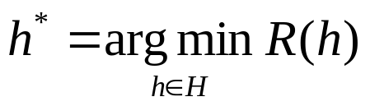
Risk
A loss function is a measure of the classification quality
Example: the 0-1 loss:
Risk – the expected loss:
Assuming a distribution D over the data XxY, the risk is the expected probability of returning a wrong prediction on a sample drawn randomly from D
The learning algorithms aims to find a hypothesis with a minimal risk:

Slide 10
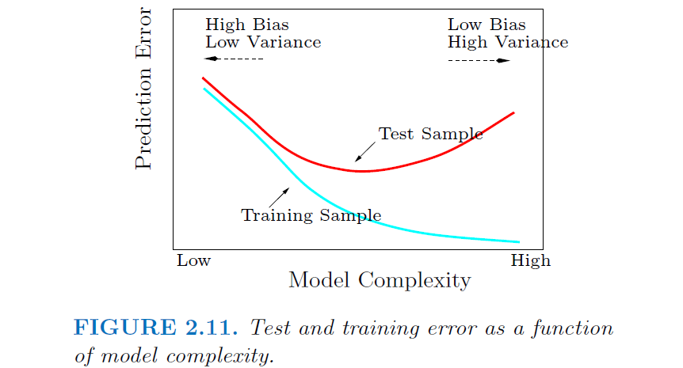
Notes:
] T. Hastie, R. Tibshirani, and J. Friedman, The Elements of Statistical Learning: Data Mining, Inference, and Prediction, Springer.

Slide 11
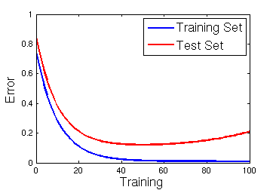
Training Vs. Test Error
The hypotheses class H should be complicated enough to capture important properties of the data
But too complex hypotheses may cause overfit

Slide 12
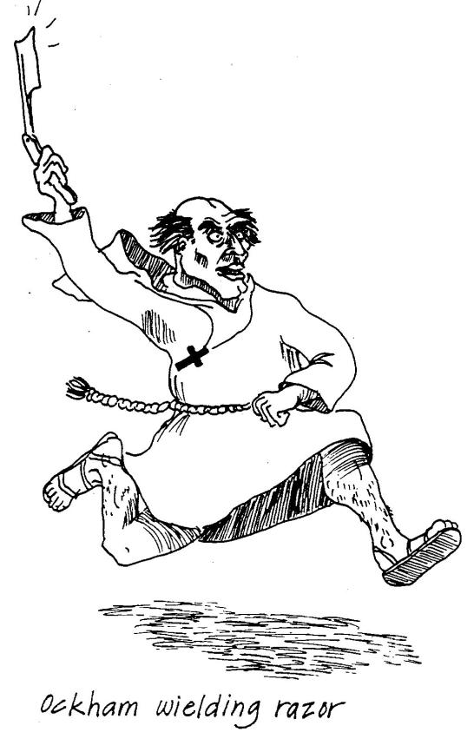
Occam’s Razor
14th-century English logician, theologian and Franciscan friar
Occam’s razor is a guiding principle for explaining phenomena
"Plurality must never be posited without necessity"
When considering a few explanations of the same phenomenon
choose the simplest one, having fewest parameters

Slide 13
Bias-Complexity (Bias-Variance) Tradeoff
Two components contribute to the generalization error:
  Approximation error – due to the final size of our hypotheses class H
    Inherent bias since H does not necessarily contain the true hypothesis
    Decreases as |H| grows
  Estimation error – due to the final training set
    Increases with the size (complexity) of H
    Variance increases with the size of H
    Decreases with m (the training set size)

Slide 14
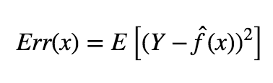
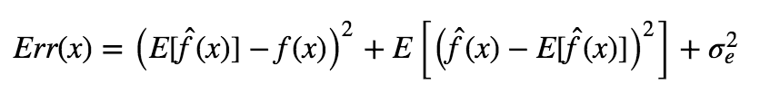

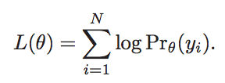
Loss Function
T. Hastie, R. Tibshirani, and J. Friedman, The Elements of Statistical Learning: Data Mining, Inference, and Prediction, Springer.

Slide 15
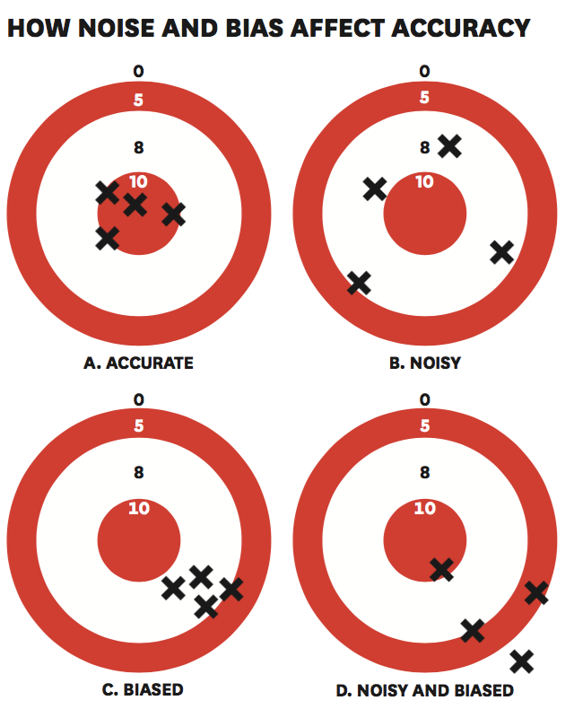
Noise vs Bias
Aiming at robustness - reduce variance of answers
Kahneman, Rosenfield, Gandhi & Blaser showed that a learning algorithm can detect the noisy cases and clean those

Slide 16
Designing a decision support system
Creating a system that provides a recommendation of what would be best intervention from a final set of potential interventions requires the following
Need to address all aspects of the PICOT format - patient population of interest (P), intervention or area of interest (I), comparison intervention or group (C), outcome (O), and time (T)
Define ‘best’ – typically done by defining Outcome as binary (good/bad), ranked list (different levels of achievements) or with continuous variables that can be measured some Time after the Intervention of interest.
Second step – define the Population of interest, if relevant the Comparison groups as well, the features to be used for making the decision and clean outliers

Slide 17
About AIDS/HIV

Slide 18
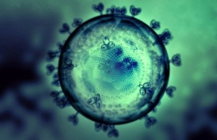
HIV
35 M
At the end of 2013, 35 million people were living with HIV
70%
70% of the people living with HIV, live in Sub Saharan Africa
90%
90% of the children living
with HIV, live in Africa
Notes:
איידס זאת מחלה שעברה שינויים רבים, ממחלה סופנית למחלה כרונית, ממחלה שאפיינה בעיקר קהילות מסוימות, עד כדי כך שקרא לה
Gay-related immune deficiency (GRID) was the name first proposed in 1982 to describe an "unexpected cluster of cases"^{[1]} of what is now known as AIDS

Slide 19
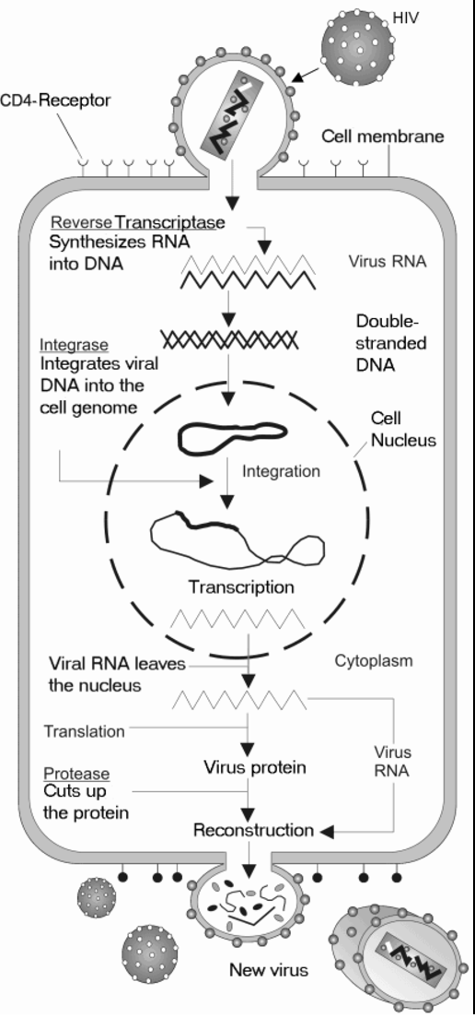
The life cycle of the virus
Relevant drugs include
Protease Inhibitors
Reverse Transcriptase Inhibitors
Integrase Inhibitors

Slide 20
HIV: EuResist
65,000
Data coming from 10 European
centers covers medical records of 65,000 patients in the past 20 years
160,000
Information for 160K therapy regimens provided to the patients
50,000 x
400
Information of 200 million amino acids of the virus RT and PRO proteins
Notes:
The double-edged sword – on the one hand we have data we can use from european databases to predict the best treatment and help people. The other edge is to use a ground up approach with demographic and geographic data combined with medical literature to prevent HIV, increase awareness, and reduce the number of patients…

Slide 21
Standard datum definition
CD4
Genotype
Reason for switch
Viral load
Treatment switch
Viral load
time
0-90 days
Short-term model: 4-12 weeks
Patient demographics (age, gender, race, route of infection)
Past AIDS diagnosis
Past treatments
Past genotypes
21

Slide 22
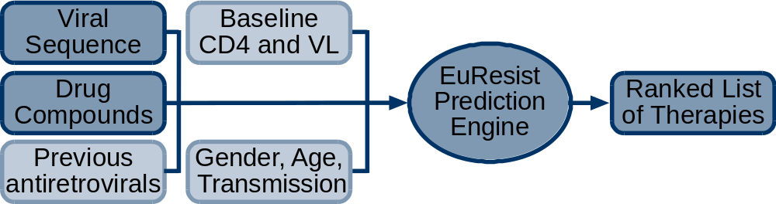
Three engines
  The Evolutionary Engine uses mutagenetic trees to compute the genetic barrier to drug resistance
  The Generative Discriminative Engine employs a Bayesian network modeling interactions between current and past antiretroviral drugs
  The Mixture of Effects Engine includes second and third-order variable interactions between drugs and mutations

Slide 23
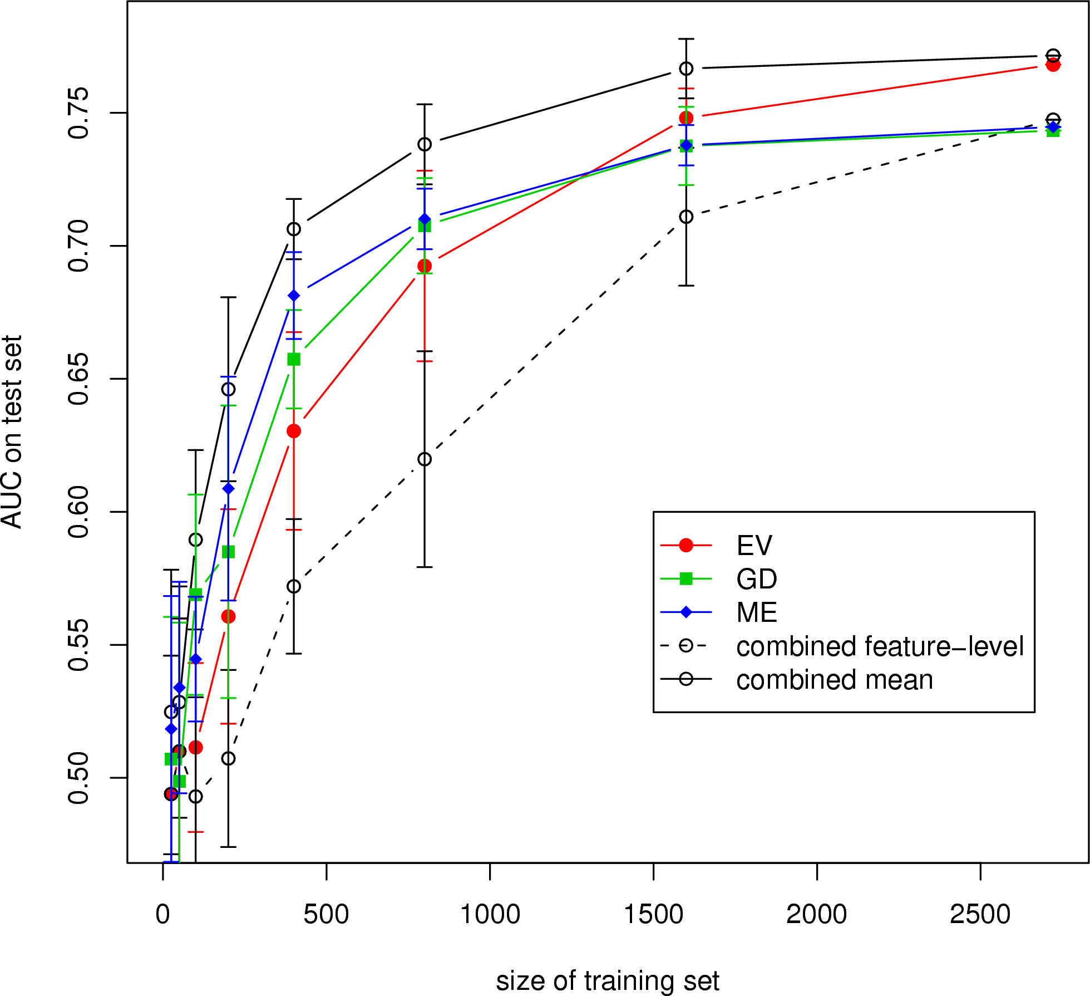
Different prediction algorithms, different results
Notes:
IBM joined Yale in a study of the status of mother to child hiv transmission.

Slide 24
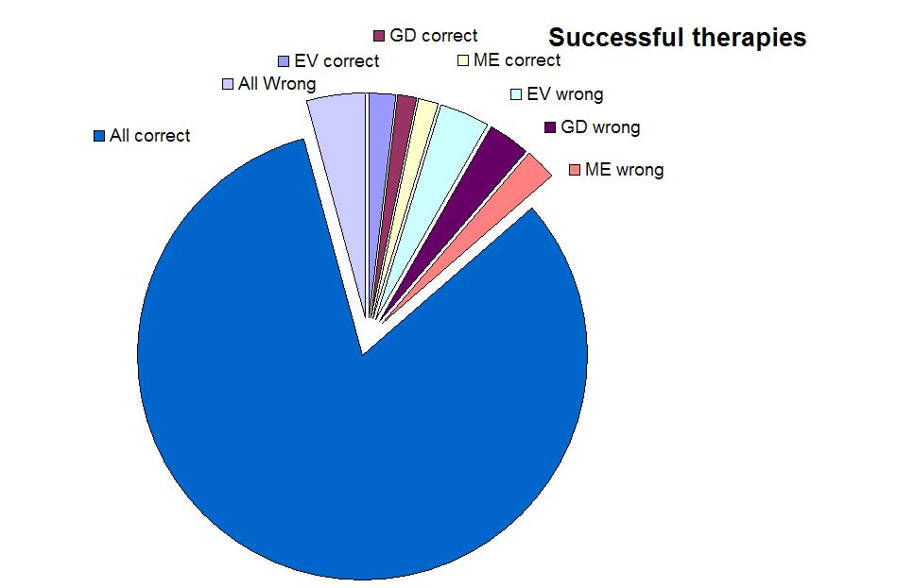
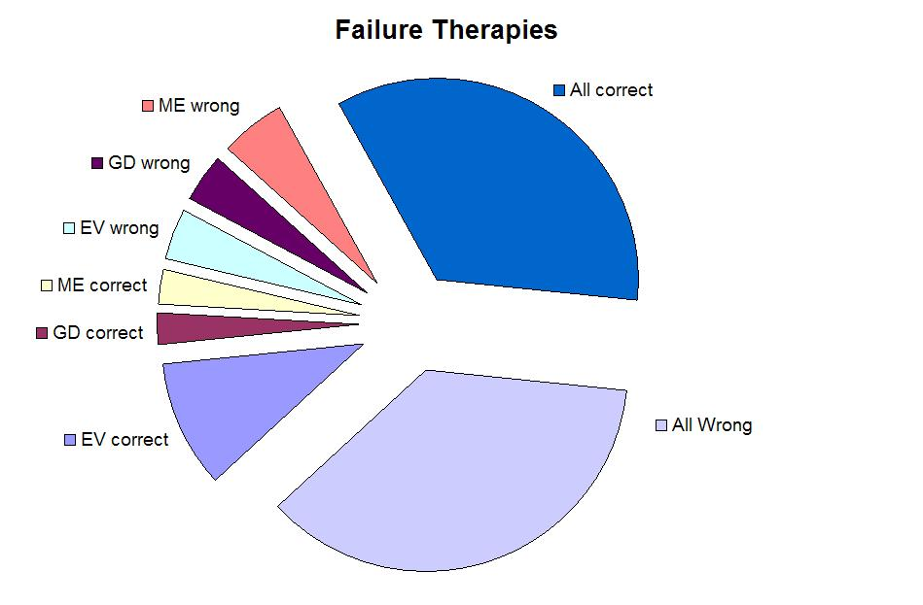
Comparison of performances
A comparison of the three engines prediction on failure or success therapy – where they fail or succeed together and where there is a single winner
In the training (test) set 350 (35) failing therapies are predicted
to be successful by all three engines. 145 (16) of these achieve a
VL measure below 500 copies per mililiter once during the course
of therapy. Of the remaining 550 (64) failing cases in the training
(test) set 100 (13) have a VL measure below 500 copies per mililiter
once during the course of the therapy. A Fisher's Exact test results in
a p-value of 4.8⋅10⁻¹⁴ (0.011) on the training (test) set.
“Happy families are all alike; every unhappy family is unhappy in its own way”
  Leo Tolstoy, Anna Karenina, Chapter 1, first line
Notes:
Tend to dissagree on failure therapies. We found out that indeed these therapies are more noisy as they might have been a success in the short term.

Slide 25
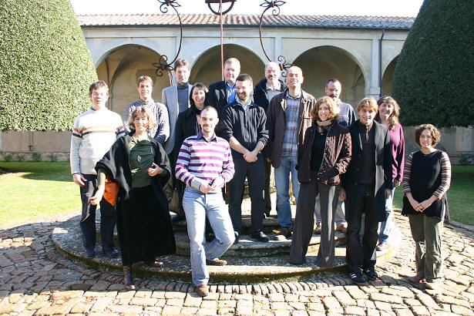
EuResist partners @ EHR meeting, 27/03/2007
Thank You
תודה
Grazie
Danke
Köszönöm
Tack

Slide 26
Designing a decision support system (Cont)
Last step can be performed using one of the following approaches
Embed patients in a metric and recommend intervention based on similarity
Predict outcome for different intervention and use the prediction (e.g. likelihood of success in the binary case) to rank recommendations
Predict what would be the intervention, performed as a multi-label challenge, requires cleansing data based on outcome. In other words, predict the physician choice, might want to learn only from past good choices as defined by the outcome.

Slide 27
Selection bias
Selection bias is the selection of individuals, groups or data for analysis in such a way that proper randomization is not achieved, thereby ensuring that the sample obtained is not representative of the population intended to be analyzed.
Thirty-five percent of published reanalyses led to changes in findings that implied conclusions different from those of the original article about the types and number of patients who should be treated.
Ebrahim S, Sohani ZN, Montoya L, Agarwal A, Thorlund K, Mills EJ, Ioannidis JPA. Reanalyses of Randomized Clinical Trial Data. JAMA. 2014;312(10):1024-1032.

Slide 28

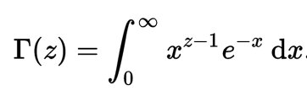

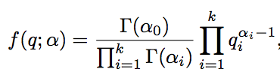
Multinomial distribution/ Gamma Function

Slide 29
Naïve Bayes classifier: words and topics
A set of labeled documents is given:
{C_{d},w_{d}: d=1,…,D}
Note: classes are mutually exclusive
. . .
c₁=8
c₁=2
c_{d}=D
. . .
Pet
Dog
Milk
Cat
Eat
Food
Dry
Milk
Bread

Slide 30
Simple model for topics
Given the topic words are independent
The probability for a word, w, given a topic, z, is θ_{wz}
C
W
N_{d}
D
P({w,C}| θ) = Π_{d}P(C_{d})Π_{nd}P(w_{nd}|C_{d},θ)

Slide 31
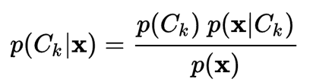
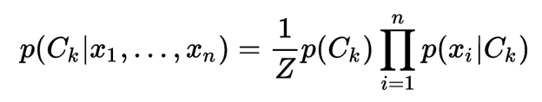
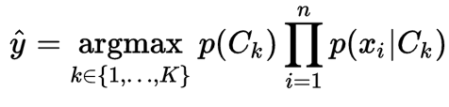
A classification algorithm

Slide 32
Evaluation of multi-class
Confusion matrix
 | Predicted C=1 | Predicted C=2 | Predicted C=3
True C=1 | 20 | 2 | 1
True C=2 | 3 | 15 | 0
True C=3 | 3 | 6 | 12

Slide 33
LDA model
α
θ_{d}
β
z
Φ_{z}
K
w
N_{d}
D

Slide 34

Sampling in the LDA model
The update rule for fixed α,β and integrating out θ
Provides point estimates to θ and distributions of the latent variables, z.

Slide 35
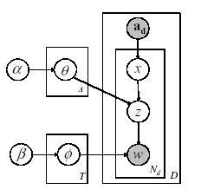
The generative process
Let’s assume authors A₁ and A₂ collaborate and produce a paper
  A₁ has multinomial topic distribution θ₁
  A₂ has multinomial topic distribution θ₂
For each word in the paper:
  Sample an author x (uniformly) from A₁, A₂
  Sample a topic z from a θ_{X}
  Sample a word w from a multinomial topic distribution

Slide 36
Inference in the author topic model
Estimate x and z by Gibbs sampling
(assignments of each word to an author and topic)
Estimation is efficient: linear in data size
Infer from each sample using point estimations:
  Author-Topic distributions (Θ)
  Topic-Word distributions (Φ)

Slide 37
Data and Topic Models
Author-topic-word model for 70k authors and 300 topics built from 162,489 Citeseer abstracts
Each word in each document assigned to a topic
For the subset of 131,602 documents that we know the year
  Group documents by year
  Calculate the fraction of words each year assigned to a topic
  Plot the resulting time-series, 1990 to 2002
Caveats
  Data set is incomplete (see next slide)
  Variability (noise) will be high for 2001 and 2002

Slide 38
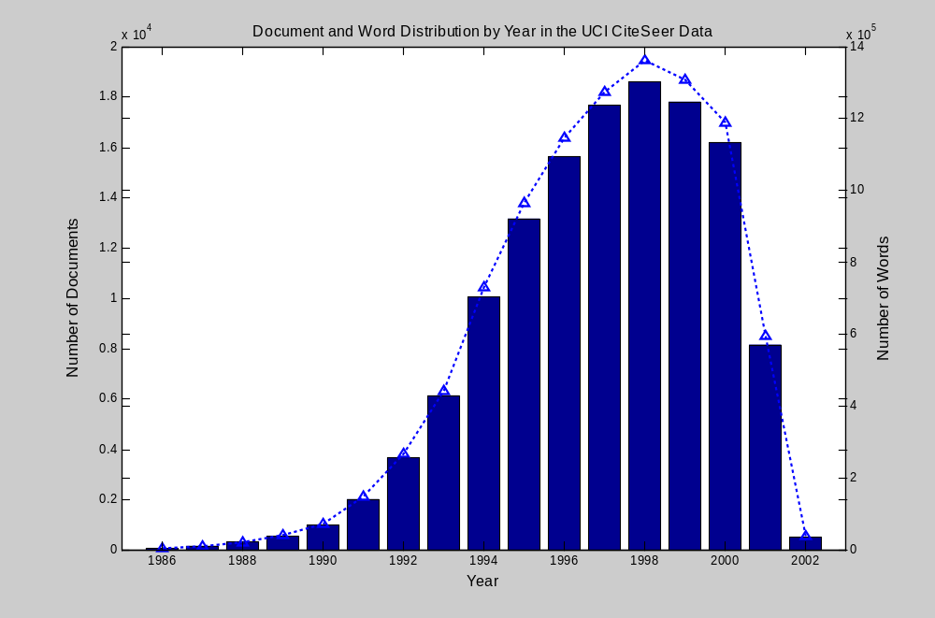

Slide 39
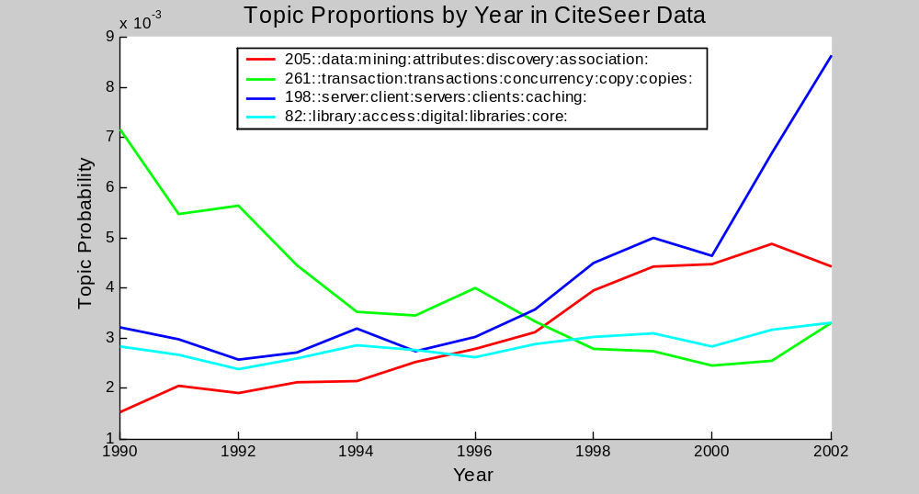
Trends within Database Research

Slide 40
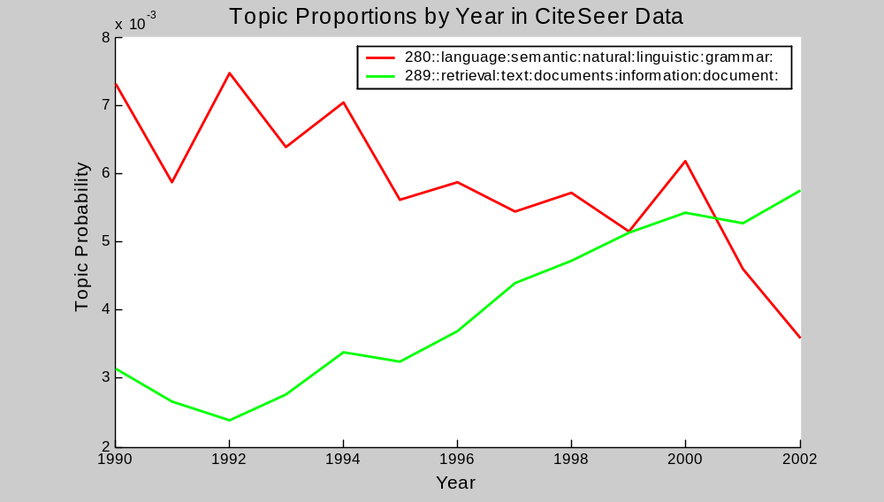
NLP and IR

Slide 41
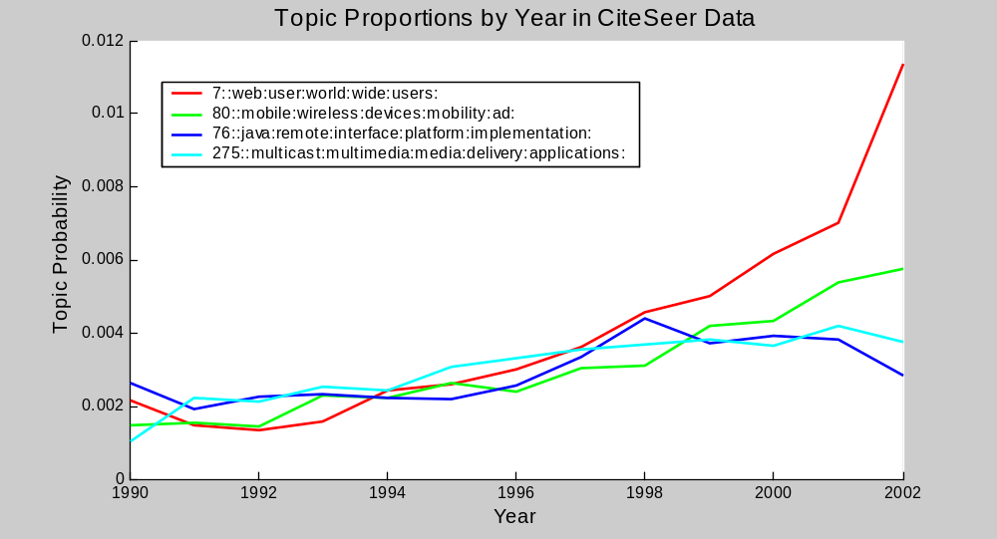
Rise in Web/Mobile topics

Slide 42
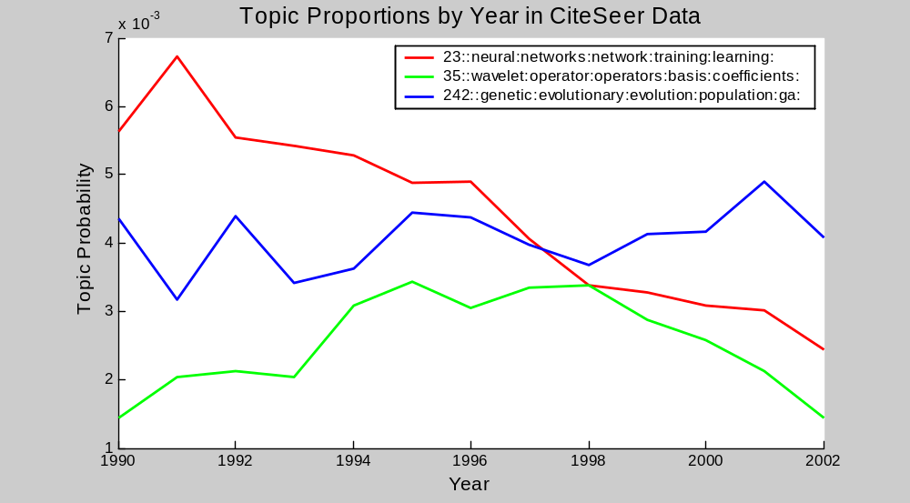
(Not so) Hot Topics

Slide 43
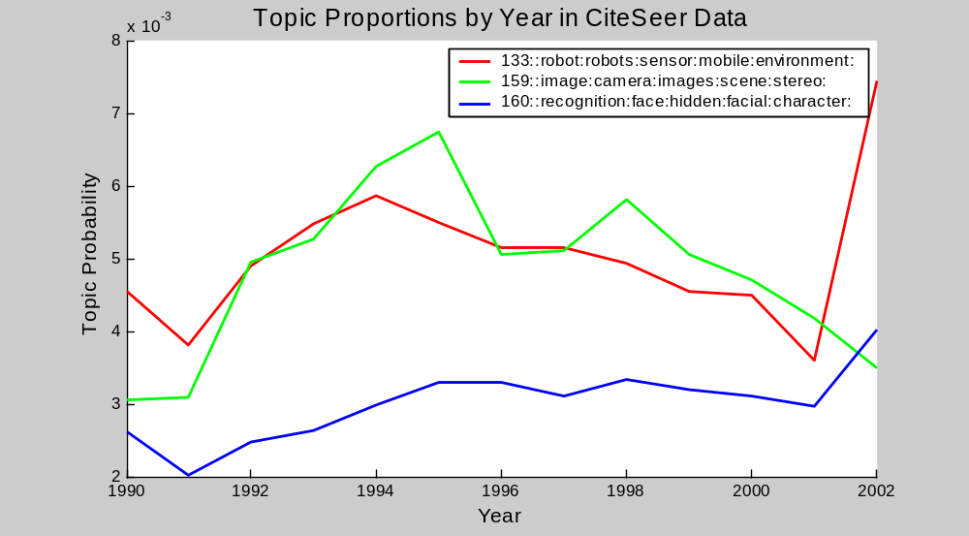
Vision and Robotics

Slide 44
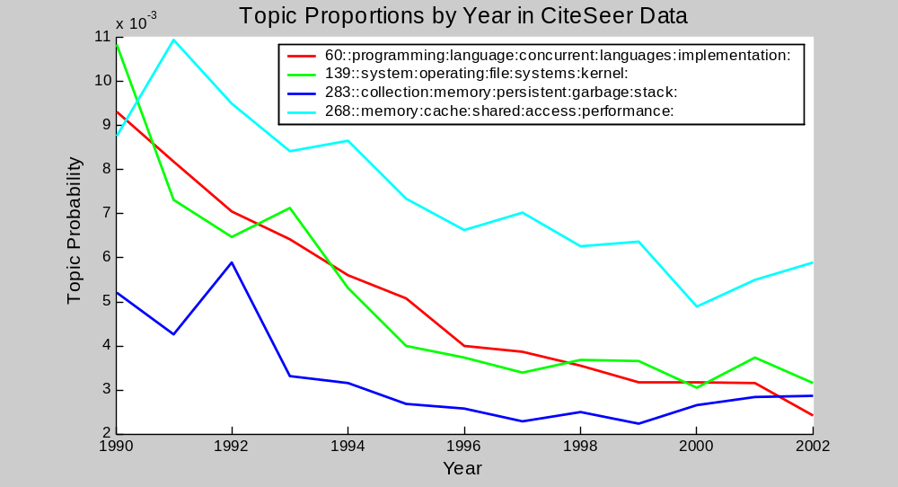
Decline in programming languages, OS, ….

Slide 45
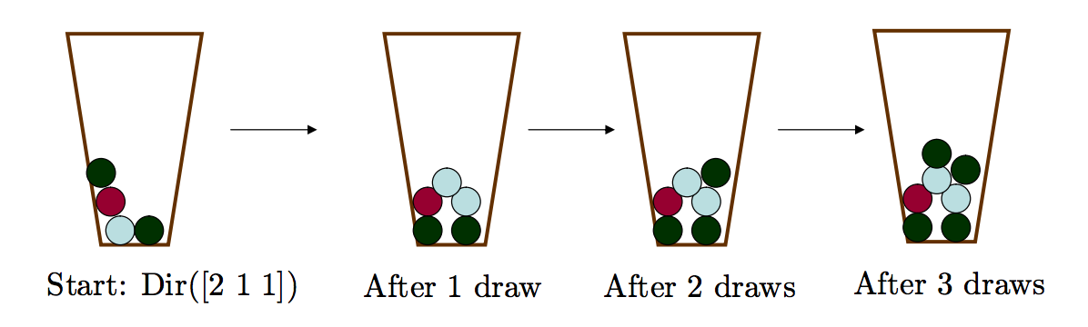
Polya’s Urn
Notes:
George Pólya (/ˈpoʊl.jə/; Hungarian: Pólya György, pronounced [ˈpoːjɒ ˈɟørɟ]; December 13, 1887 – September 7, 1985) was a Hungarian mathematician. He was a professor of mathematics from 1914 to 1940 at ETH Zürich and from 1940 to 1953 at Stanford University. He made fundamental contributions to combinatorics, number theory, numerical analysis and probability theory. He is also noted for his work in heuristics and mathematics education.^{[2]}

Slide 46

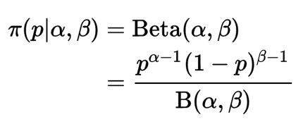
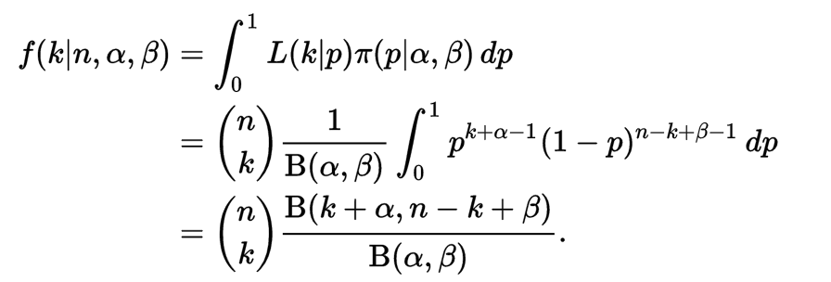
Binary Case

Slide 47
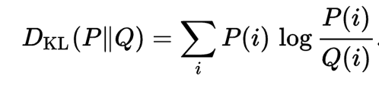
Metric –distance function
Non negative
Identity
Symmetry
Triangle inequality
Kullback-Leibler Diversion

Slide 48
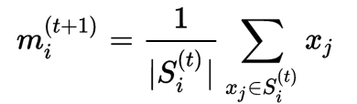
K-means
Pick initial set of k means: {m}
Iterate until convergence on two steps – assignment and update

Slide 49
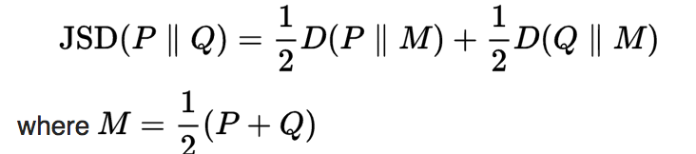
Jensen-Shannon Divergenece
Symmetric
Smooth

Slide 50
Retrospective Study of Effectiveness of a treatment
 | Z=1 (Old treatment) | Z=0 (New treatment)
Y=1 (Success) | 210 | 262
Y=0 (Failure) | 201 | 327
Success Ratio | 51.1% | 44.5%
The average treatment effect: E[Y(Z=1)- Y(Z=0)]
P(Y=1|Z=1)*1+ P(Y=0|Z=1)*0-[P(Y=1|Z=0)*1+ P(Y=0|Z=0)*0]

Slide 51
Simpson Paradox
 | Z=1 (Old treatment) Y=1, Y=0, Success ratio |  |  | Z=0 (New treatment) Y=1, Y=0, Success ratio
X₁=1 (Severe) | 46 | 86 | 34.9% | 136 | 252 | 35.1%
X₁=0 (Mild) | 164 | 115 | 58.8% | 126 | 75 | 62.7%
 | Z=1 (Old treatment) | Z=0 (New treatment)
Y=1 (Success) | 210 | 262
Y=0 (Failure) | 201 | 327
Success Ratio | 51.1% | 44.5%

Slide 52
The average treatment effect
E[Y_{i}(1) − Y_{i}(0)] = P(Y=1|Z=1)*1+P(Y=0|Z=1)*0-[P(Y=1|Z=0)*1+P(Y=0|Z=0)]
E[Y_{i}(1) − Y_{i}(0)] = 0.511-0.445=0.066
Knowing about the confounder
E[Y_{i}(1) − Y_{i}(0)] = [P(X₁=1)*P(Z=1|X₁=1)*P(Y=1|Z=1)*1+
P(X₁=0)* P(Z=1|X₁=0)*P(Y=1|Z=1)*1]-[P(X₁=1)*P(Z=0|X₁=1)*P(Y=1|Z=0)*1+ P(X₁=0)*P(Z=0|X₁=0)*P(Y=1|Z=0)*1]
0.5*0.282*0.511+0.5*0.611*0.511-
[0.5*0.718*0.489+0.5*0.389*0.489]
0.456-0.541= -0.043

Slide 53
Naive Bayes
 | x1=1 | x2=1 | x3=1 | x4=1 | x5=1 | x6=1 | x7=1 | x8=1 | x9=1 | x10=1 | Z=1
y=1 | 0.386 | 0.498 | 0.481 | 0.520 | 0.536 | 0.468 | 0.542 | 0.487 | 0.521 | 0.528 | 0.445
y=0 | 0.640 | 0.496 | 0.496 | 0.519 | 0.456 | 0.456 | 0.487 | 0.460 | 0.470 | 0.519 | 0.381
P(Y=1|Z,{X})
Y
. . .
X₁
X₂
X_{N}
Z

Slide 54
Naïve Bayes classifier
P(Y=1|Z=1) = P(Z=1,Y=1)/P(Z=1)= P(Z=1|Y=1) P(Y=1) /P(Z=1)
=0.445*0.5/(0.445*0.5+0.381*0.5)=0.539
P(Z=1|X₁=1)= P(Z=1, X₁=1)/P(X₁=1)=
[P(Z=1, X₁=1|Y=1)P(Y=1)+ P(Z=1,X₁=1|Y=0)P(Y=0)]/
[P(X₁=1|Y=1)P(Y=1)+P(X₁=1|Y=0)P(Y=0)]=
[0.445*0.386+0.381*0.640]/[0.445+0.381]=0.503

Slide 55
Sigmoid Function
P(Y=1)=1/(1+Exp(-WX))
X_{i}=0/1 Drug was administrated no/yes
Z=0/1 Obtained new/old treatment
Y=0/1 Failure/Successful treatment
Outcome
Treatment
Drug 1
Drug 2
Drug 3
Drug N

Slide 56
Code generating the data (matlab/octave)
X=randi([0,1],1000,10);
WZ = [-2 0.1 0.1 0.1 0.1 0.1 0.1 0.1 0.1 0.1];
WY = [-2 0.1 0.1 0.1 0.1 0.1 0.1 0.1 0.1 0.1];
tZ=mtimes(WZ,X');
tY=mtimes(WY,X');
pZ=1./(1+exp(-1*tZ));
pY=1./(1+exp(-1*tY));
Z=binornd(1,pZ);
Y=binornd(1,pY);
Notes:
octave:127> tY=mtimes(WY,X'); octave:128> tZ=mtimes(WZ,X'); octave:129> pY=1./(1+exp(-1*tY)); octave:130> pZ=1./(1+exp(-1*tZ)); octave:131> Y=binornd(1,pY); octave:132> Z=binornd(1,pZ); octave:133> old1 = X(:,1)'+X(:,2)';
for i=1:10 > > old1 = X(:,i)'; > > cooc(i,1)=length(find(old1==1 &Z==1) ); > > cooc(i,2)=length(find(old1==1 &Z==0) ); > > cooc(i,3)=length(find(old1==1 &Y==1) ); > > cooc(i,4)=length(find(old1==1 &Y==0) ); > > cooc(i,5)=length(find(old1==1 &Y==1 & Z==1) ); > > cooc(i,6)=length(find(old1==1 &Y==0 & Z==1) ); > > cooc(i,7)=length(find(old1==1 &Y==1 & Z==0) ); > > cooc(i,8)=length(find(old1==1 &Y==0 & Z==0) ); > > end

Slide 57
True model probabilities
P(Y=1|Z)=Sum_{X}{ P(Y=1,Z|X)/ P(Z|X) P(X) }
=Sum_{X}{P(Y=1|X)P(Z|X)/ P(Z|X) P(X) }
The average treatment effect for the true model is 0
It does not matter what the value of Z is
Notes:
DeNumSum=0; for i=1:2 for j=1:2 for k=1:2 for m=1:2 for l=1:2 for n=1:2 for a=1:2 for b=1:2 for c=1:2 for d=1:2 x(1)=i-1; x(2)=j-1; x(3)= k-1; x(4)=m-1; x(5) =l-1; x(6)=n-1; x(7)=a-1; x(8)=b-1; x(9)=c-1; x(10)=d-1;DeNumSum=DeNumSum+1/(1+exp(-1*mtimes(WZ,x')));end end end end end end end end end end
NumSum=0; for i=1:2 for j=1:2 for k=1:2 for m=1:2 for l=1:2 for n=1:2 for a=1:2 for b=1:2 for c=1:2 for d=1:2 x(1)=i-1; x(2)=j-1; x(3)= k-1; x(4)=m-1; x(5) =l-1; x(6)=n-1; x(7)=a-1; x(8)=b-1; x(9)=c-1; x(10)=d-1;NumSum=NumSum+1/(1+exp(-1*mtimes(WY,x')))/(1+exp(-1*mtimes(WZ,x')));end end end end end end end end end end

Slide 58
Propensity score
The probability of a person being assigned to a particular treatment given a set of observed covariates.
P(Z=1|X)
If the treatment and control groups have identical propensity score distributions, then all the covariates will be balanced between the two groups
“no unmeasured confounders” assumption: the assumption that all variables that affect treatment assignment and outcome have been measured
In the example data, there is a big different between X₁=1 and X₁=0
P(Z=1|X₁=1) = 0.282 P(Z=1|X₁=0) = 0.611
Given two patients: X_{i} i=2:10 identical and X₁ different, the treated and untreated groups are unbalanced

Slide 59


Inverse Probability of Treatment Weighting Using the Propensity Score
e_{i}= P(Z=1|X_{i}); propensity score
Averaged treatment effect
Calculate the averaged treatment effect given the model
1/[(1+exp(-W_{Y}X)) (1+exp(-W_{Z}X))]/[1/(1+exp(-W_{Z}X))]-1/(1+exp(-W_{Y}X)) [1-1/(1+exp(-W_{Z}X))]/[1-1/(1+exp(-W_{Z}X))]=0

Slide 60
Propensity score matching
Calculate the propensity score per unit (patient)
Find units in the treated/intervened and untreated/no intervention groups that has similar scores
Generate a new data with two groups where the participants are selected based on matched propensity scores
Typically the final dataset is smaller than the original
Use the newly generated data to calculate the average treatment effect

Slide 61
Causal concepts
Causal effect of a treatment/intervention involves the comparison between outcomes have the unit was applied to (a patient was subjected to the intervention)
Assuming treatment/intervention is compared each independently at the same conditions/time
Note
The definition depends on the potential outcome but it does not depend on which outcome was actually observed
The causal effect is the comparison of the potential on the same unit at the same conditions in time post-intervention

Slide 62
Estimation of causal effect
Requires understanding of the assignment mechanism
Consistent model of the data generation enables detection of causal effects
Causality estimands are comparisons of the potential outcomes that would have been observed under different exposures of units to treatments/interventions
Causal Inference for Statistics, Social, and Biomedical Sciences: An Introduction
Imbens, Guido W.; Rubin, Donald B.

Slide 63

Medicine begins with storytelling
Patients tell stories to describe illness; doctors tell stories to understand it. Science tells its own story to explain diseases

Slide 64
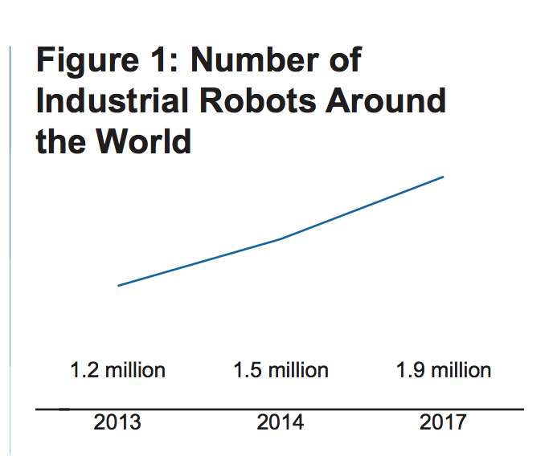
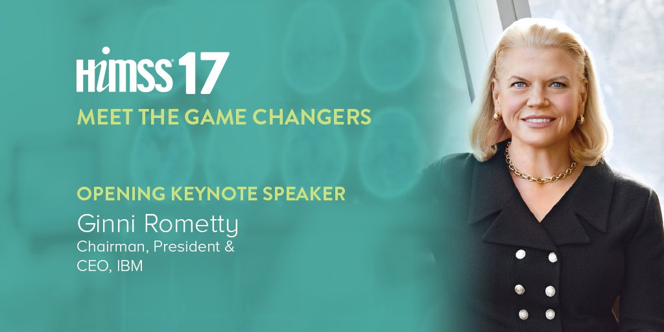
AI based tools being used by physicians
AIDS: Stanford HIVDB, EuResist, more
Heart: First FDA Approval For Clinical Cloud-Based Deep Learning In Healthcare (Deep learning, 1000 images, support radiologists)
Septic alert (personalized prediction of severe sepsis)
Notes:
http://www.forbes.com/sites/bernardmarr/2017/01/20/first-fda-approval-for-clinical-cloud-based-deep-learning-in-healthcare/#6d0b0d2d46e6
https://www.ncbi.nlm.nih.gov/pmc/articles/PMC4261595/
https://en.wikipedia.org/wiki/John_Snow#Cholera
The data deluge
Medical Pendulum (estrogen replacement for women after menopause)
Overstesting
http://datathon.arcadiasolutions.com/about/
Why most published research findings are false, PLOS Medicine
Leo Anthony Celi
A “datathon” model to support cross-disciplinary collaboration

Slide 65
Open Challenges
Causality
High dimensional very heterogynous data
Ever learning systems
Privacy preserving

Slide 66
Hippocratic Oath
I swear by Apollo The Healer, by Asclepius, by Hygieia, by Panacea, and by all the Gods and Goddesses, making them my witnesses, that I will carry out, according to my ability and judgment, this oath and this indenture. To hold my teacher in this art equal to my own parents; to make him partner in my livelihood; when he is in need of money to share mine with him; to consider his family as my own brothers, and to teach them this art, if they want to learn it, without fee or indenture; to impart precept, oral instruction, and all other instruction to my own sons, the sons of my teacher, and to indentured pupils who have taken the physician’s oath, but to nobody else. I will use treatment to help the sick according to my ability and judgment, but never with a view to injury and wrong-doing. Neither will I administer a poison to anybody when asked to do so, nor will I suggest such a course. Similarly I will not give to a woman a pessary to cause abortion. But I will keep pure and holy both my life and my art. I will not use the knife, not even, verily, on sufferers from stone, but I will give place to such as are craftsmen therein.Into whatsoever houses I enter, I will enter to help the sick, and I will abstain from all intentional wrong-doing and harm, especially from abusing the bodies of man or woman, bond or free. And whatsoever I shall see or hear in the course of my profession, as well as outside my profession in my intercourse with men, if it be what should not be published abroad, I will never divulge, holding such things to be holy secrets. Now if I carry out this oath, and break it not, may I gain for ever reputation among all men for my life and for my art; but if I transgress it and forswear myself, may the opposite befall me.[

